Slide 1
CSE488 Big Data Analytics
Lab Mini Project on Course Advising List
Group Members:
1. Md. Iftekhar Hossain Khan (2020-3-60-073)
2. Nishat Vasker (2020-2-60-209)

Slide 2
CSE 488, Lab Mini Project on Course Advising List
Frameworks/Libraries Used:
PySpark
Pandas
Seaborn
Streamlit

Slide 3
CSE 488, Lab Mini Project on Course Advising List
Contents:
Overview of the dataset
Preprocessing the dataset
Descriptive Analytics
Visualization Tasks
Predictive Analytics
Web App (Recommendation System) with Streamlit

Slide 4
CSE 488, Lab Mini Project on Course Advising List
Overview of the dataset:
No. of columns = 11
No. of rows = 2960
No. of courses = 53
columns considered:
StudentId | int
CreditsCompleted | float
takencredit | float
takennocourse | float
C1 to C7 | object

Slide 5
CSE 488, Lab Mini Project on Course Advising List
Preprocessing the dataset:
For Handling the nulls in the courses (C1 to C7):
Removed Null using SQL-Like Expression of PySpark
Combined the C1 to C7 into Course Array
Output
StudentId | Rest of the columns … | Courses
1 | … | [CSE110, ECO101, MAT205, PHY109]
2 | … | [CSE207, CSE209, MAT205, PHY209]
… | … | …
20 | … | [CHE109, CSE110, ENG102, MAT102, STA102]

Slide 6
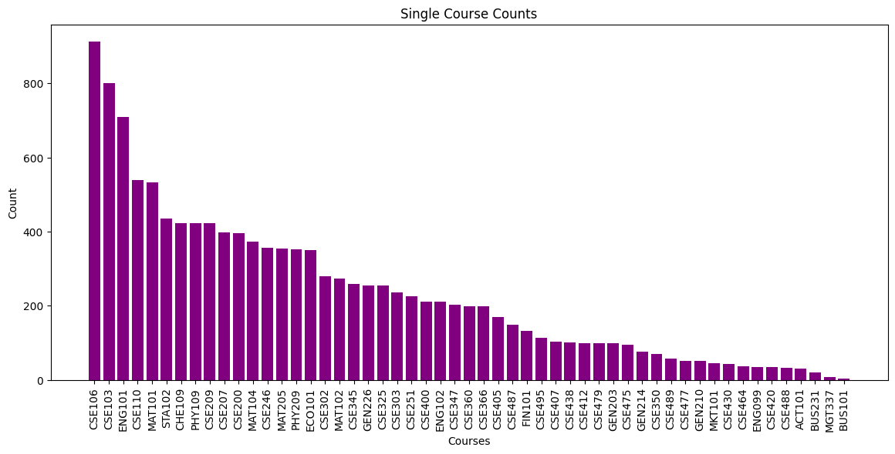
CSE 488, Lab Mini Project on Course Advising List
Descriptive Analytics:
Frequency Analysis

Slide 7
CSE 488, Lab Mini Project on Course Advising List
Descriptive Analytics:
Most popular and least popular course:
 | Course | Count
Most Popular | CSE106 | 913
Least Popular | BUS101 | 4

Slide 8
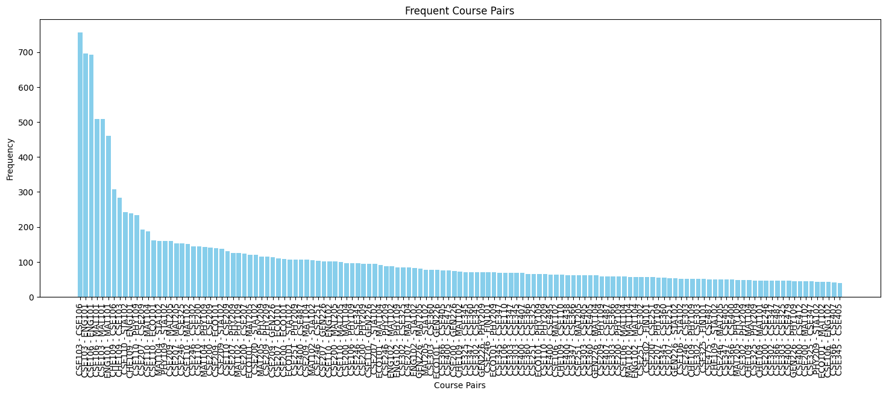
CSE 488, Lab Mini Project on Course Advising List
Descriptive Analytics:
Pattern Analysis (Pairs)

Slide 9
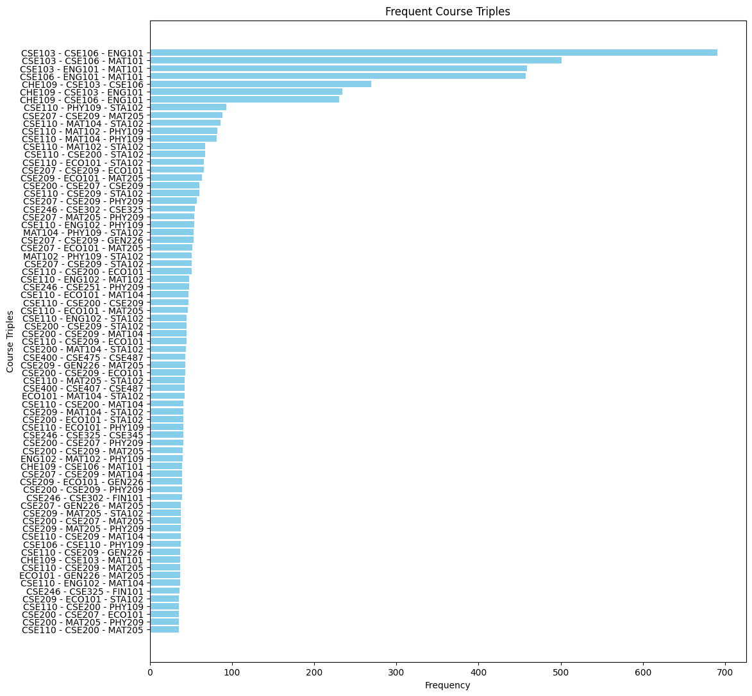
CSE 488, Lab Mini Project on Course Advising List
Descriptive Analytics:
Pattern Analysis (Triples)

Slide 10
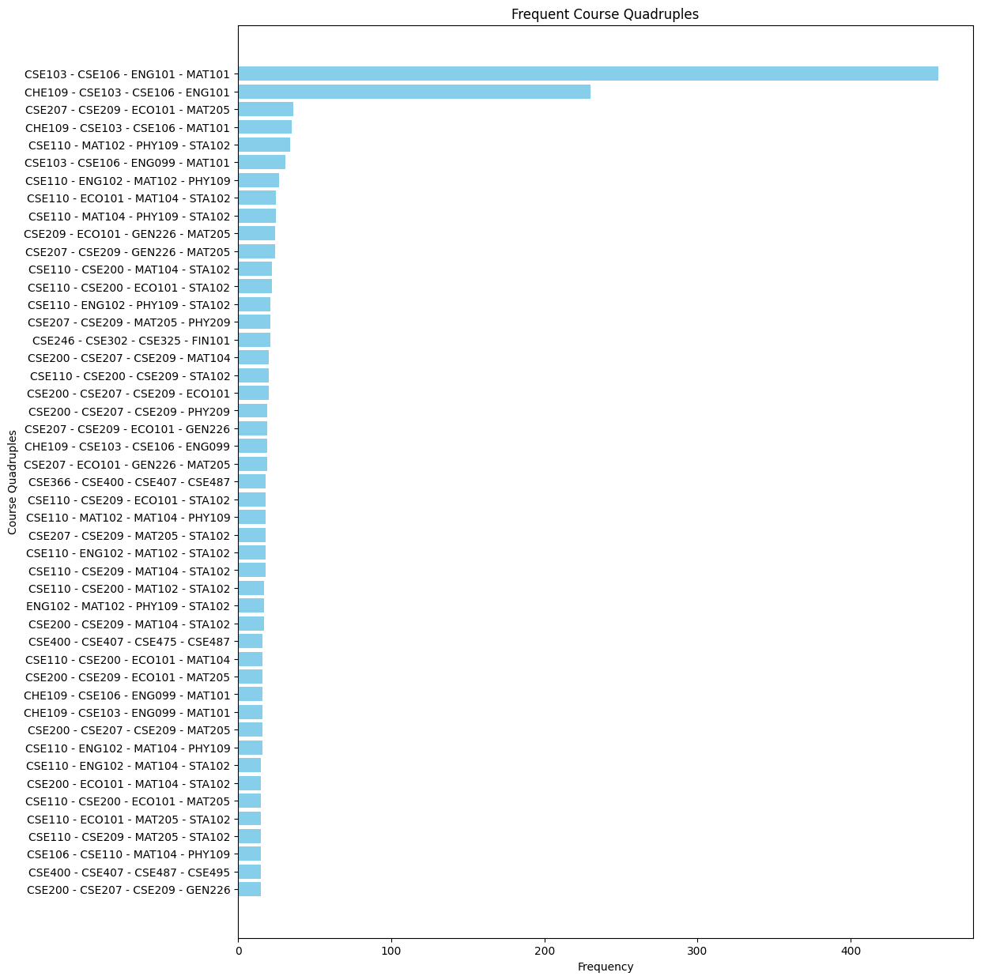
CSE 488, Lab Mini Project on Course Advising List
Descriptive Analytics:
Pattern Analysis (Quadruples)

Slide 11
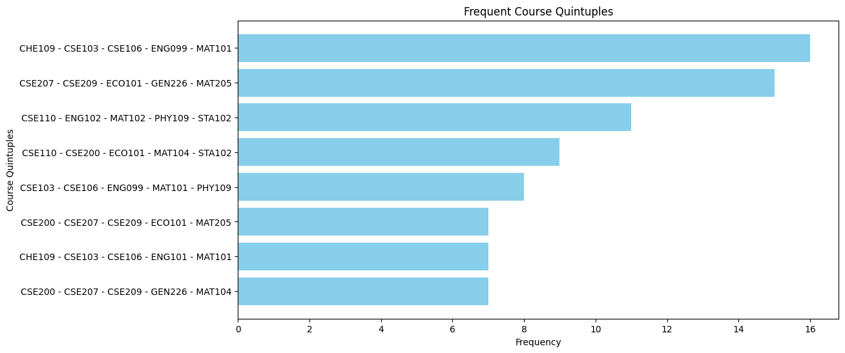
CSE 488, Lab Mini Project on Course Advising List
Descriptive Analytics:
Pattern Analysis (Quintuples)

Slide 12
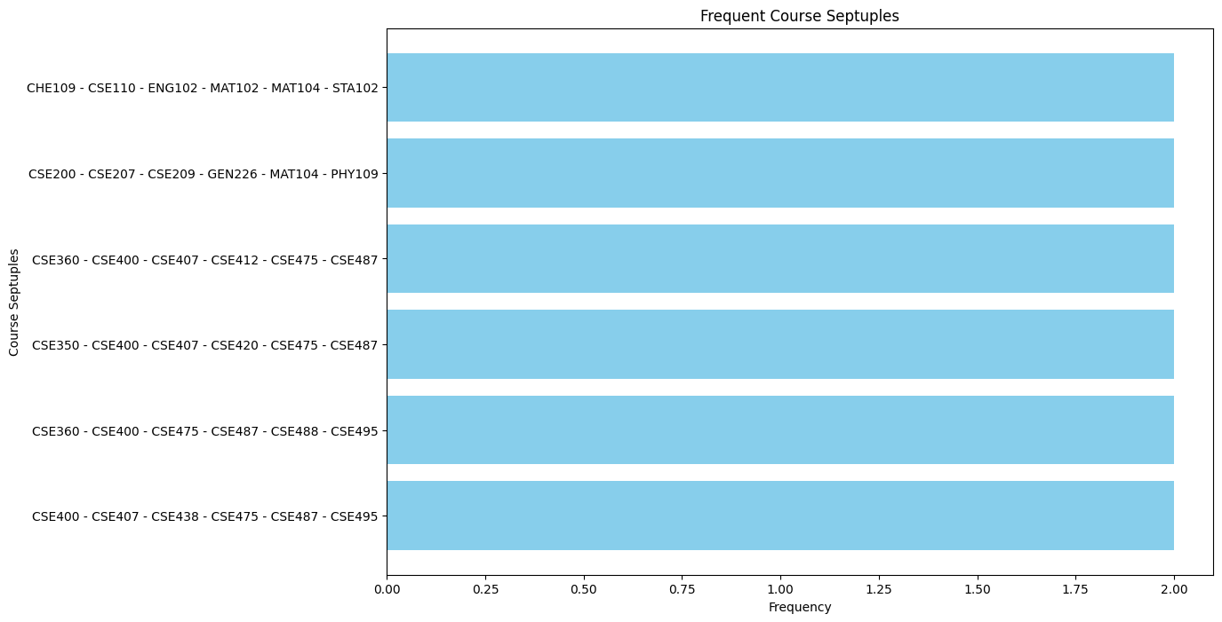
CSE 488, Lab Mini Project on Course Advising List
Descriptive Analytics:
Pattern Analysis (Septuples)

Slide 13
CSE 488, Lab Mini Project on Course Advising List
Descriptive Analytics:
Statistical Measure:
 | Mean | Median | Mode
CreditsCompleted | 42.559 | 33.5 | 0.0
takencredit | 14.468 | 14.5 | 14.5
takennocourse | 4.171 | 4.0 | 4

Slide 14
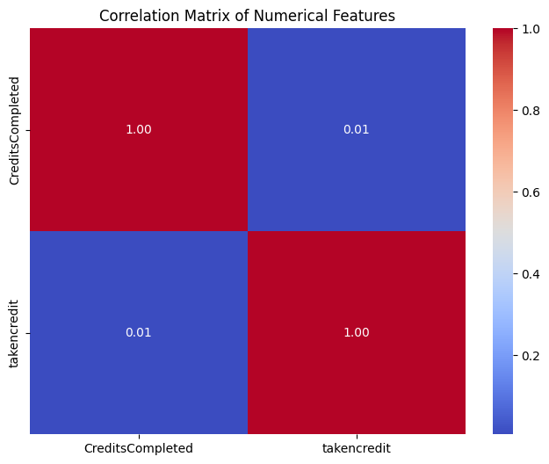
CSE 488, Lab Mini Project on Course Advising List
Descriptive Analytics:
Confusion Matrix:
correlation : 0.005571148471276035
There is no linear relationship between the taken credit and Creditscompleted

Slide 15
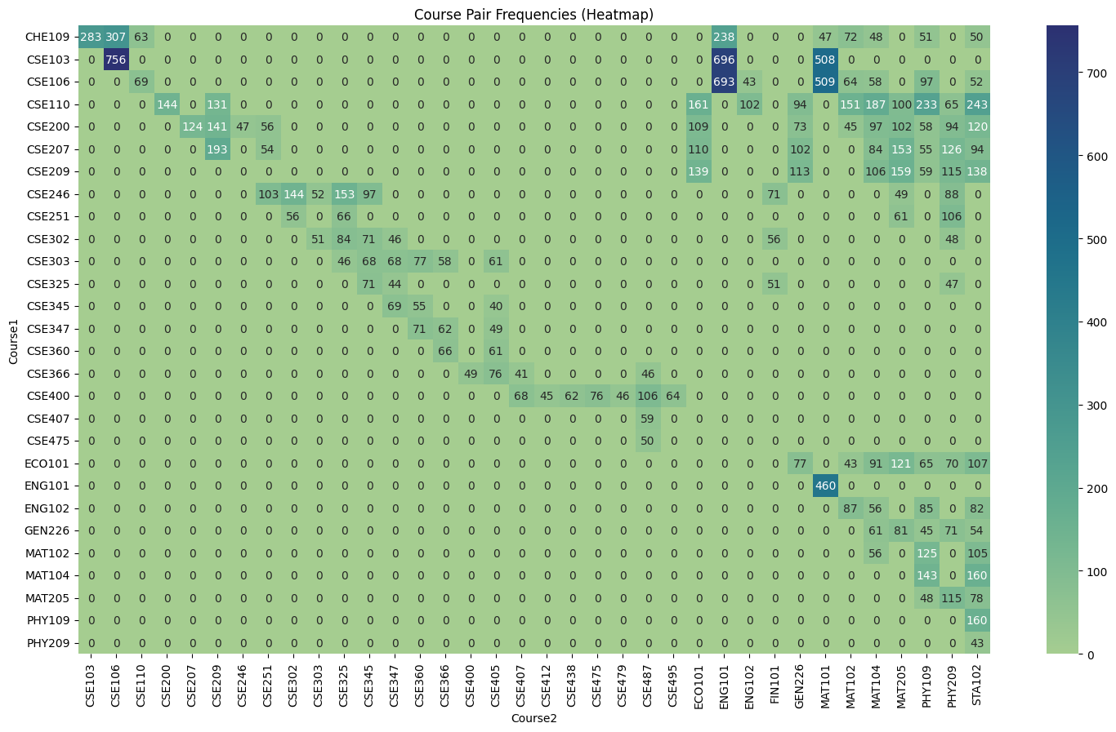
CSE 488, Lab Mini Project on Course Advising List
Visualization Tasks:
Combination Pattern (Heat map)

Slide 16
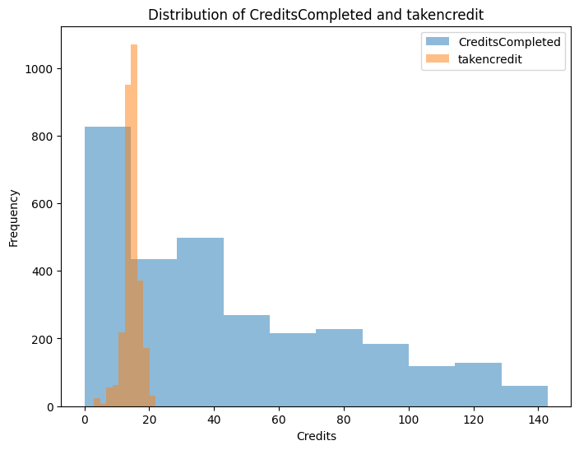
CSE 488, Lab Mini Project on Course Advising List
Visualization Tasks:
Credits Distribution

Slide 17
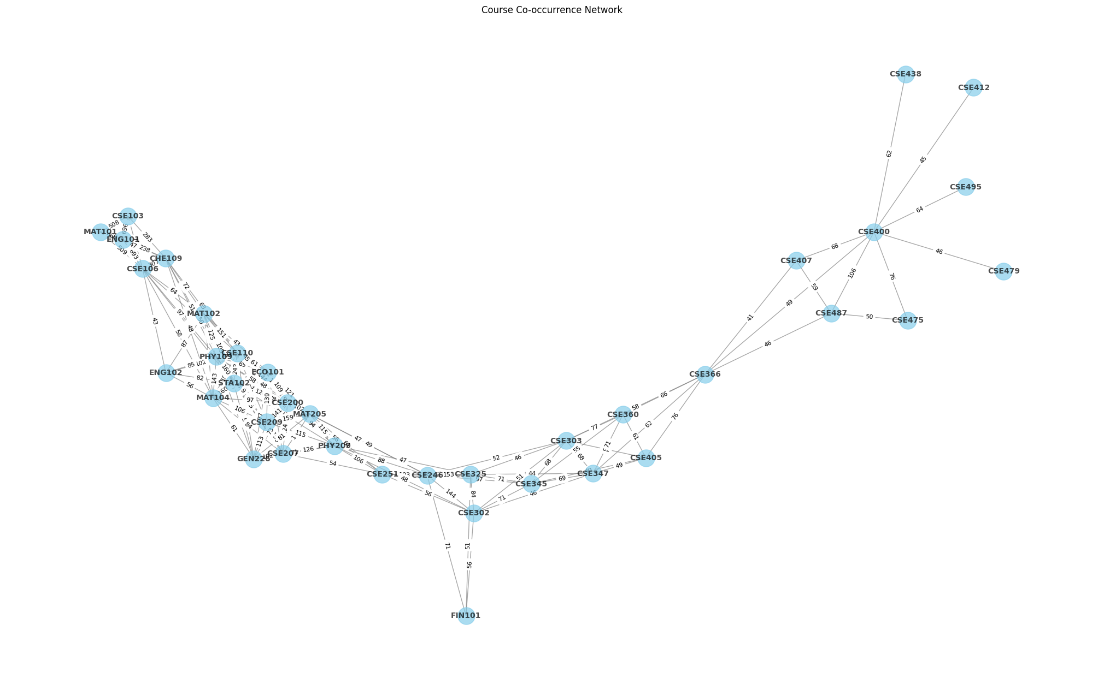
CSE 488, Lab Mini Project on Course Advising List
Visualization Tasks:
Coures Co-occurrence:

Slide 18
CSE 488, Lab Mini Project on Course Advising List
Predictive Analytics:
Association Rules Mining: (Used FPGrowth of PySpark for rules generation)
antecendent | consequent | confidence | support
[CSE407] | [CSE487] | 0.56 | 0.079
[MAT102, STA102] | [CSE110] | 0.63 | 0.022
[GEN226, CSE207] | [CSE209] | 0.51 | 0.017
[CHE109, ENG101, CSE106] | [CSE103] | 1.0 | 0.077
[CSE475, CSE487] | [CSE400] | 0.86 | 0.014

Slide 19
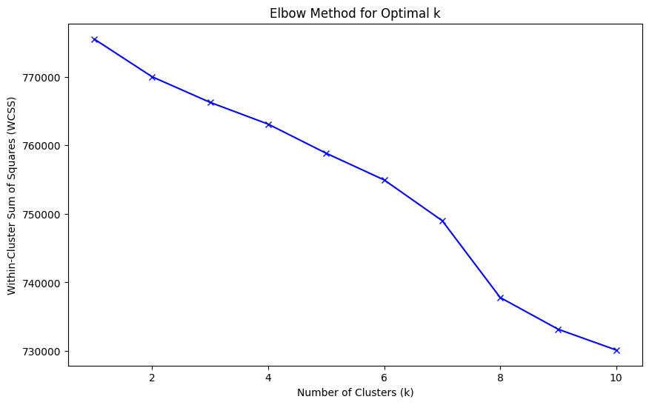
CSE 488, Lab Mini Project on Course Advising List
Predictive Analytics:
Clustering
Used K-Means Algorithm on the course columns (C1 to C7)
Used Elbow Method for Optimal K Value
PCA for Cluster Visualization
Elbow Method (K=8):

Slide 20
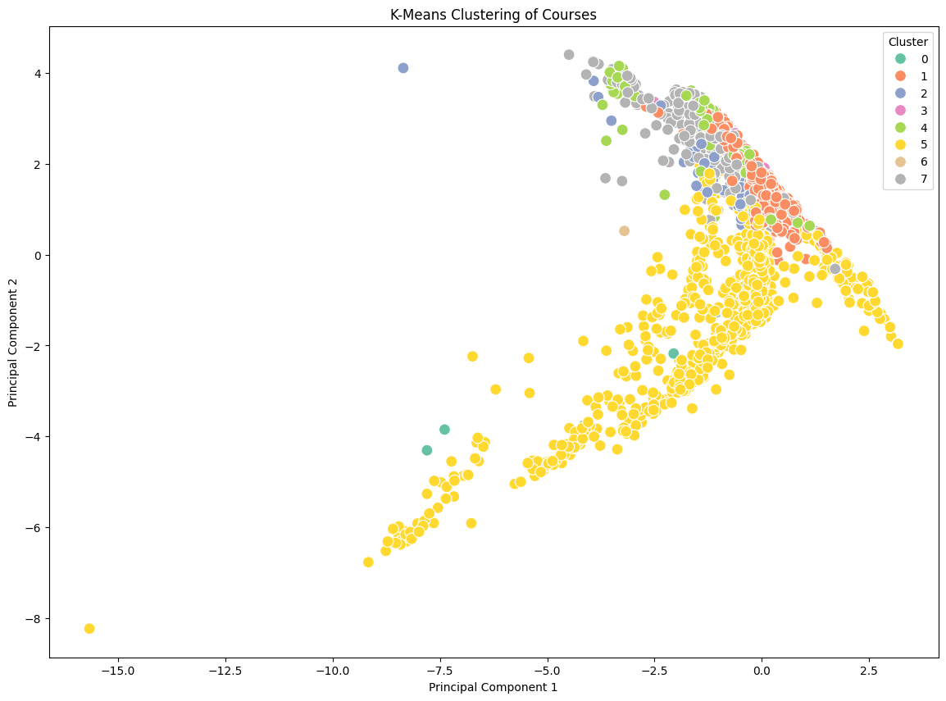
CSE 488, Lab Mini Project on Course Advising List
Predictive Analytics:
Clustering
PCA Visualization

Slide 21
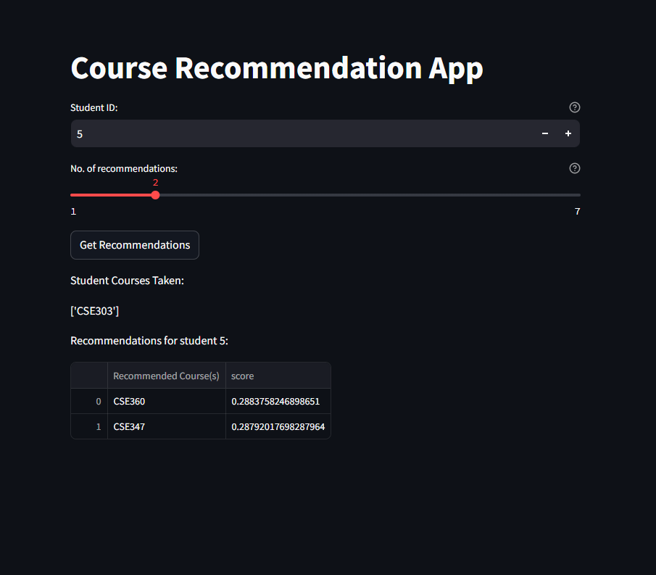
CSE 488, Lab Mini Project on Course Advising List
Web App (Streamlit):
Preview of the application

